Slide 1
Meeting 9 Teamwork and Partnership in Foster Care and Adoption

Slide 2
Partnership Building and Teamwork in Foster Care
Teamwork – a process involving at least two people working with a coordinated plan to reach the same goal. Team members have different roles and responsibilities they can be relied upon to do.
R/R
R/R
R/R
Goal
R/R
R/R
R/R

Slide 3
Partnership Building and Teamwork in Foster Care (continued)
Partnership – a relationship between two or more parties, each contributing something of value in order to receive benefits. Contributions and benefits are defined by a social contract.
A
B
Social Contract

Slide 4
Key Concepts in Child Welfare
Foster Care
Adoption
Child Protective Services
Termination of Parental Rights (TPR)
Physical Abuse
Sexual Abuse
Neglect
Well-being
Permanence
Permanency Planning

Slide 5
Key Concepts in Child Welfare (continued)
Concurrent Planning
Safety
Case Review
Timeliness
Reasonable Efforts
Full Disclosure
Searching for Relatives
Case or Family Conferencing
Permanency Hearing
Confidentiality

Slide 6
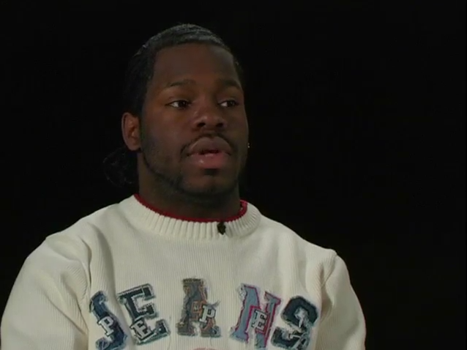
Video: Richard

Slide 7
Attachment vs. Commitment
Child’s Strengths and Needs
Informed
Adoption
Decision
Impact
Foster Family’s Strengths and Needs

Slide 8
Definition of Attachment
Attachment is the affectionate and emotional tie between people that continues indefinitely over time and lasts even when people are geographically apart.*
* Fahlberg, Vera. “Attachment and Separation” PROJECT CRAFT, Training in the Adoption of Children with Special Needs. Ann Arbor, MI: University of Michigan School of Social Work, 1980, pp. V-1 - V-93.

Slide 9
There are three main parts of communication:
Verbal – what we say (I miss you.)
Paraverbal – how we say it (I miss you. I MISS you. I miss YOU.)
Nonverbal – what our bodies say

Slide 10
Communication
Verbal
(Words)
7%
Paraverbal
(Tone)
38%
Nonverbal
(Body)
55%

Slide 11
Roadwork
Complete your final “Strengths/Needs Worksheet” and bring it to Meeting 10
Read Handouts 7 and 10

